Slide 2
Robot Framework Master slide
René Rohner

Slide 3
This is a Content Slide
Title is ALL CAPS
Rest ist up to you
Dont do too much text

Slide 4
This is a Content Slide with subtitle
Special topic for this title
Add content here please
Add another content here please
Add another content here please

Slide 5
new chapter

Slide 6
Sometime two contents are useful
2018
2019
Had a great year
First RoboCon
Had a greater year
Second RoboCon

Slide 7
Robot Framework Code Examples
*** Settings *** Library YouDemoLib
*** Test Cases ***
Insert your code here
Click Into Field Code right
Select Content Type ${myTestCase}
Describe Content on Left
Do A Great Presentation
Answer Questions
Verify Good Feedback
This test does nothing
But is a good example
You can reduce text size!

Slide 8
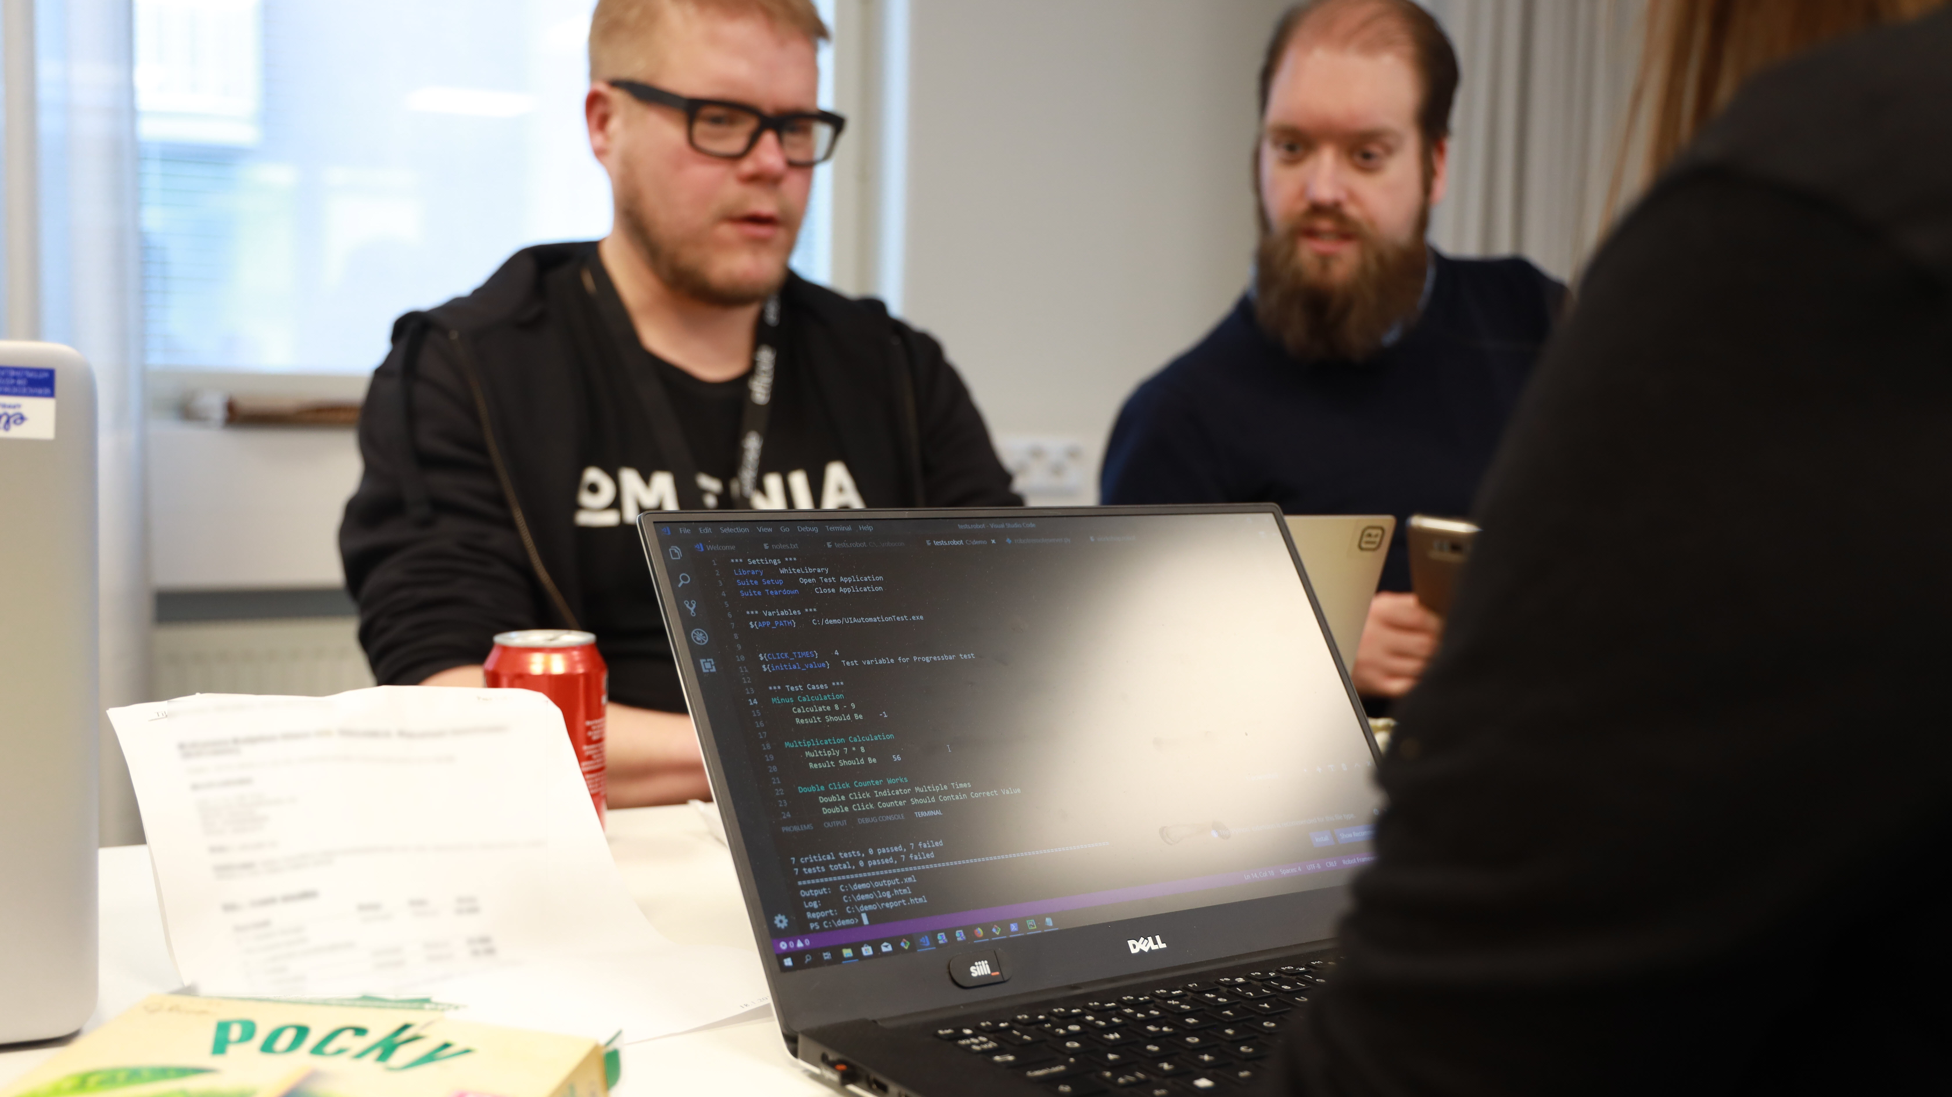
Code some nice tests

Slide 9
N
O
W
S
O
M
E
B
U
Z
Z
W
R
D

Slide 10
R
B
T
F
R
M
W
R
K

Slide 13
Robot Framework Master slide
René Rohner

Slide 14
This is a Content Slide
Title is ALL CAPS
Rest ist up to you
Dont do too much text

Slide 15
This is a Content Slide with subtitle
Special topic for this title
Add content here please
Add another content here please
Add another content here please

Slide 16
new chapter

Slide 17
Sometime two contents are useful
2018
2019
Had a great year
First RoboCon
Had a greater year
Second RoboCon

Slide 18
Robot Framework Code Examples
*** Settings *** Library YouDemoLib
*** Test Cases ***
Insert your code here
Click Into Field Code right
Select Content Type ${myTestCase}
Describe Content on Left
Do A Great Presentation
Answer Questions
Verify Good Feedback
This test does nothing
But is a good example
You can reduce text size!

Slide 19
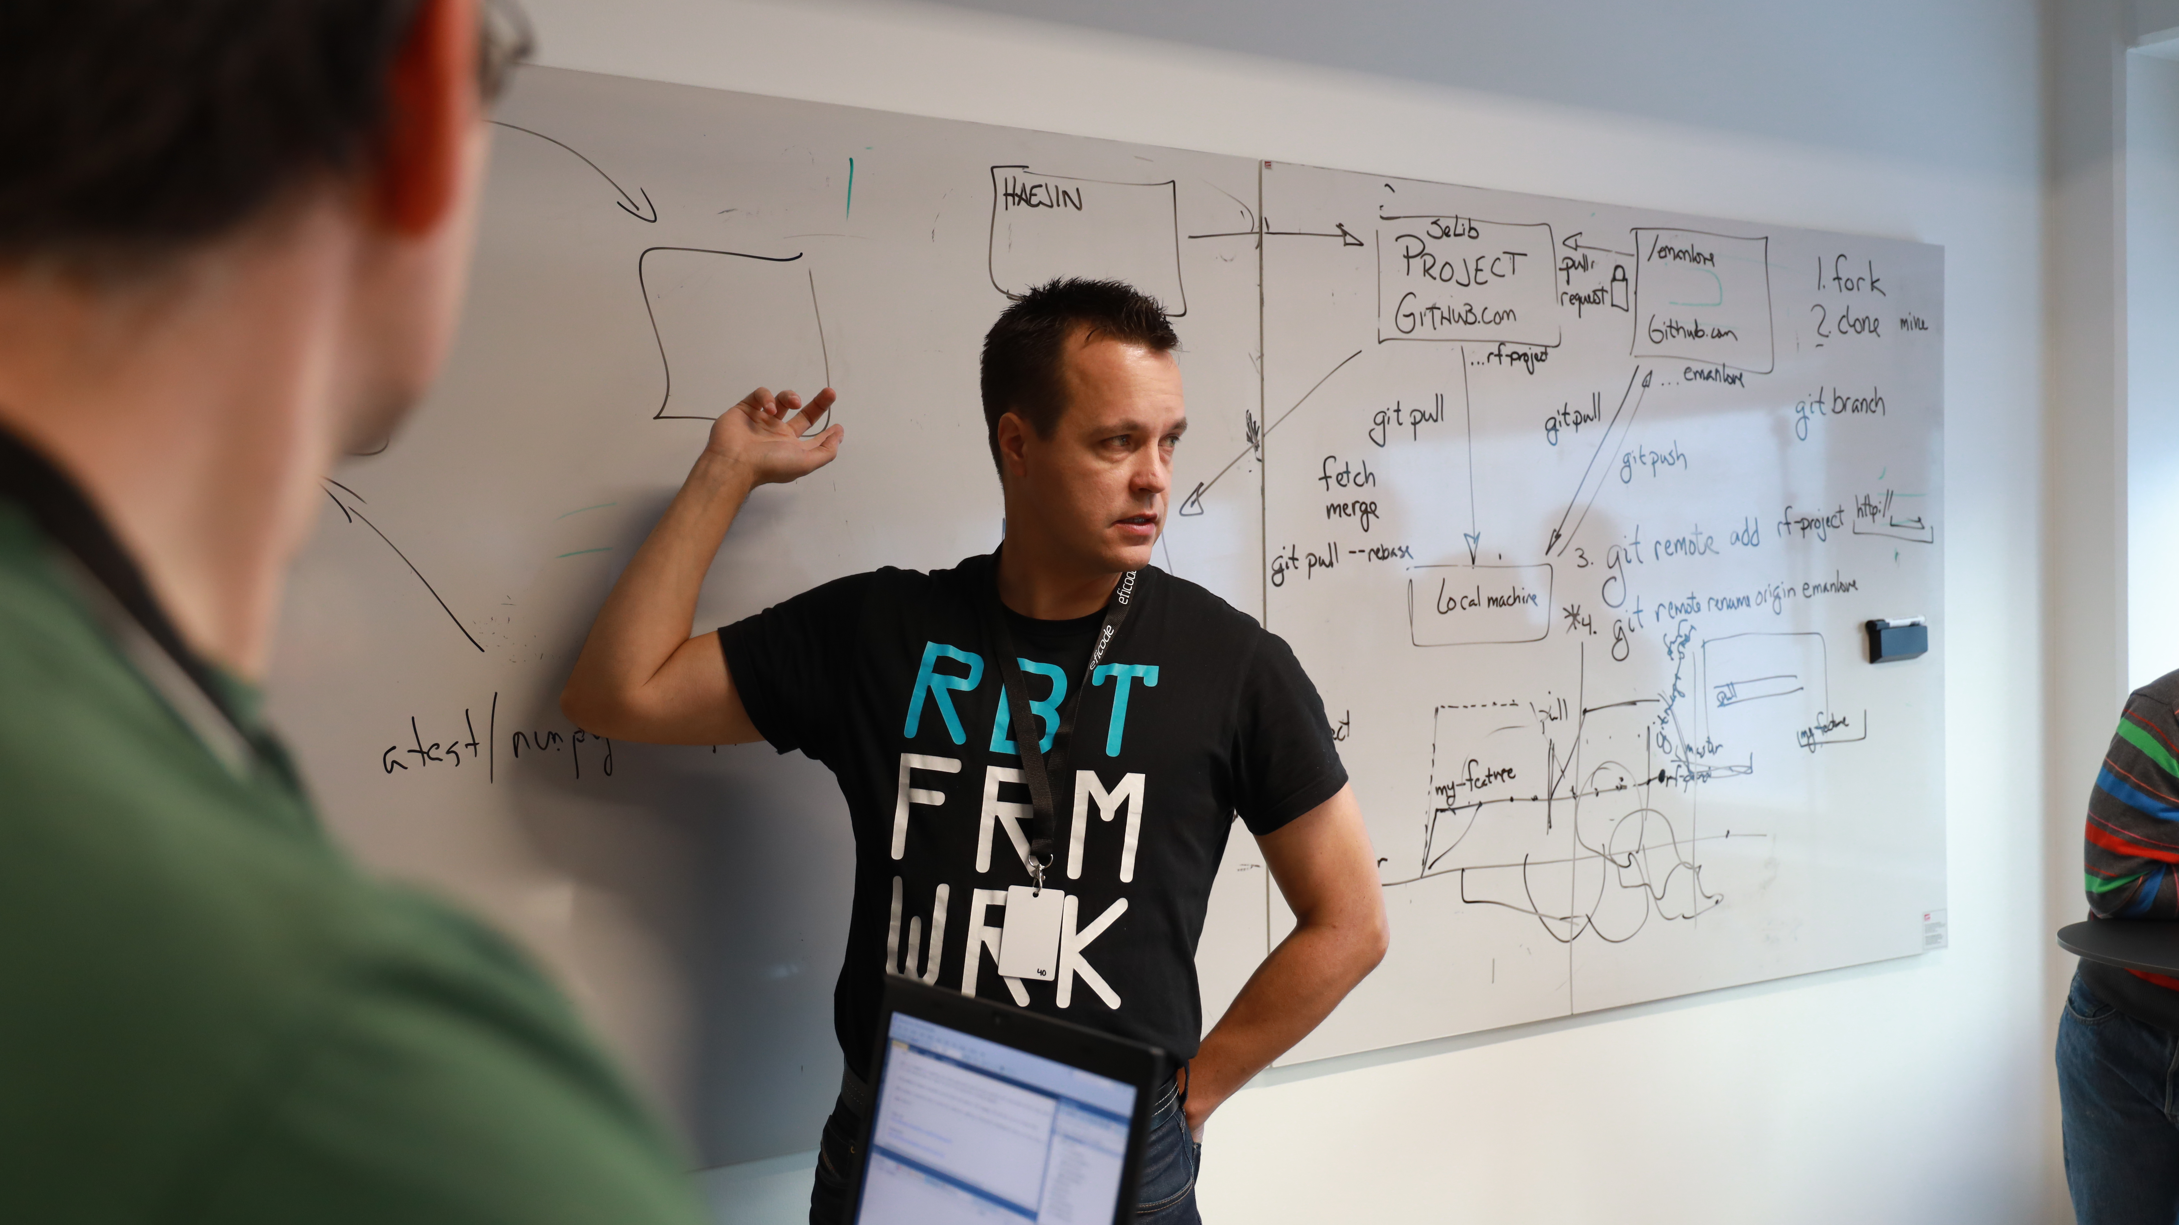
Collaborate with people

Slide 20
N
O
W
S
O
M
E
B
U
Z
Z
W
R
D

Slide 21
R
B
T
F
R
M
W
R
K

